Slide 1
Vectorization: Low rank matrix factorization

Slide 2
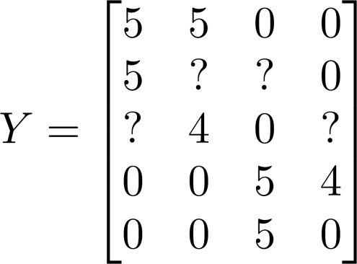
Collaborative filtering
Movie | Alice (1) | Bob (2) | Carol (3) | Dave (4)
Love at last | 5 | 5 | 0 | 0
Romance forever | 5 | ? | ? | 0
Cute puppies of love | ? | 4 | 0 | ?
Nonstop car chases | 0 | 0 | 5 | 4
Swords vs. karate | 0 | 0 | 5 | ?
Notes:
Make points have 0 mean on x1 and x2

Slide 3
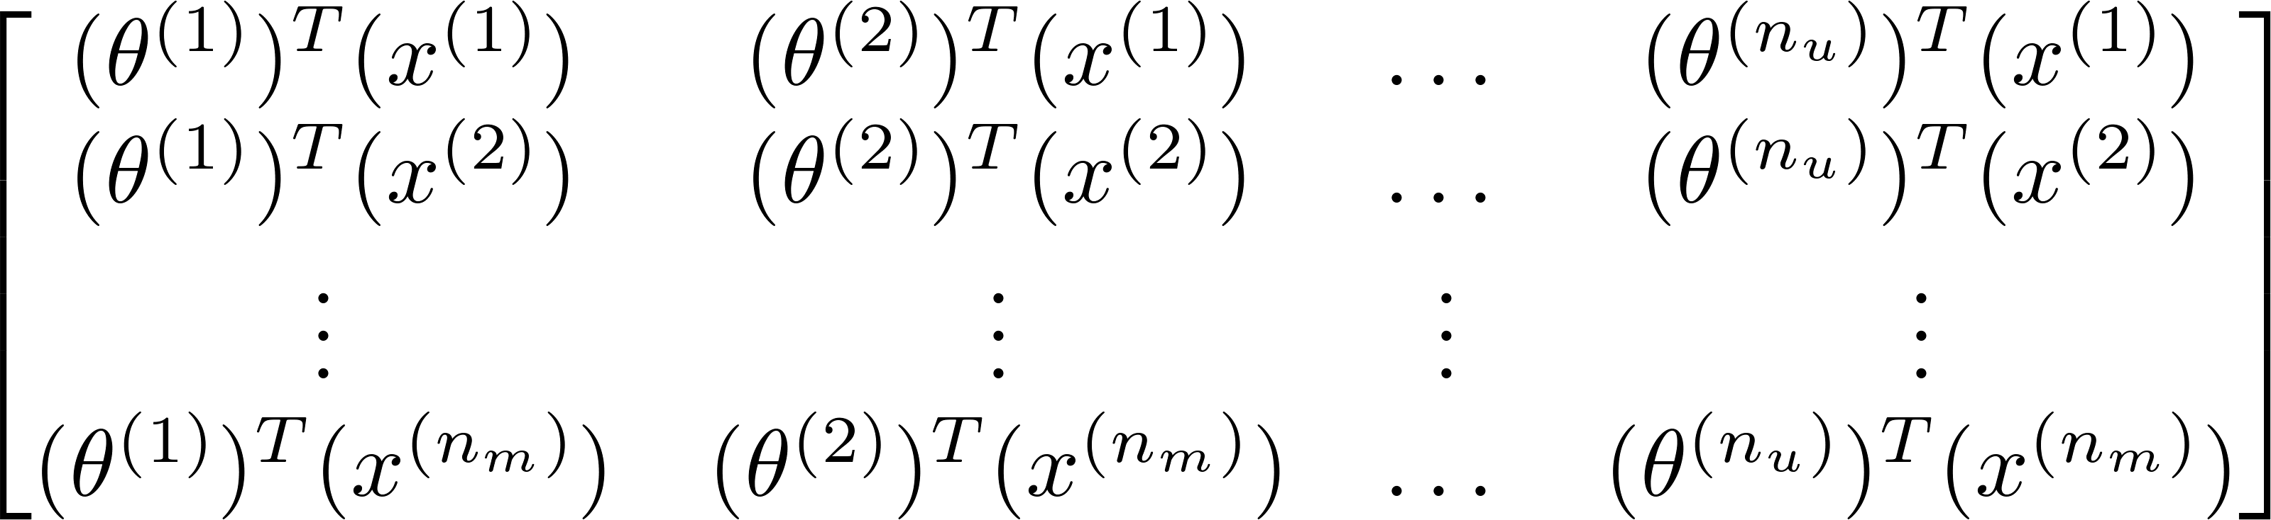
Vectorization
Collaborative filtering
Predicted ratings:
Collaborative Filtering
Notes:
Make points have 0 mean on x1 and x2

Slide 4
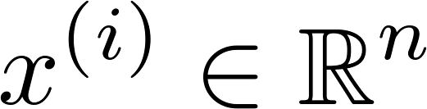
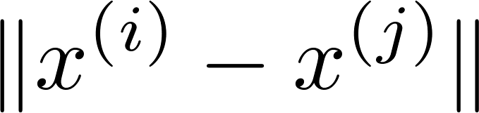
Finding related movies
For each product , we learn a feature vector .
How to find movies related to movie ?
5 most similar movies to movie :
Find the 5 movies with the smallest .
Notes:
Make points have 0 mean on x1 and x2

Slide 5
Implementational detail: Mean normalization

Slide 6
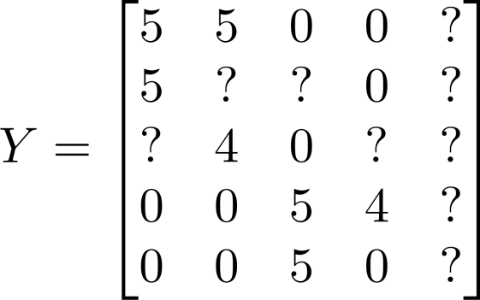


Users who have not rated any movies
Movie | Alice (1) | Bob (2) | Carol (3) | Dave (4) | Eve (5)
Love at last | 5 | 5 | 0 | 0 | ?
Romance forever | 5 | ? | ? | 0 | ?
Cute puppies of love | ? | 4 | 0 | ? | ?
Nonstop car chases | 0 | 0 | 5 | 4 | ?
Swords vs. karate | 0 | 0 | 5 | ? | ?

Slide 7
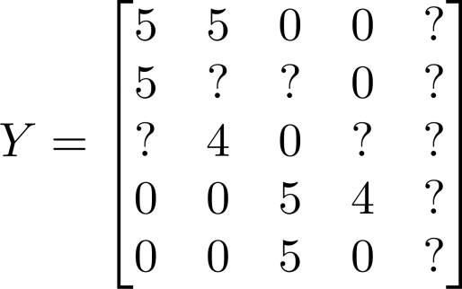
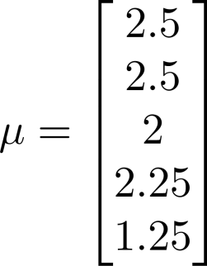
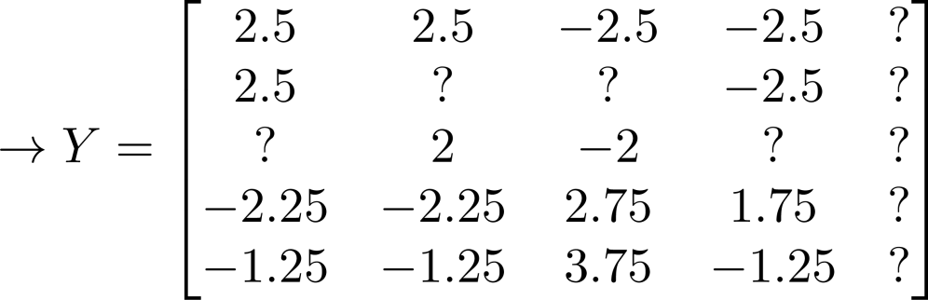

Mean Normalization:
For user , on movie predict:
User 5 (Eve):

